Slide 1
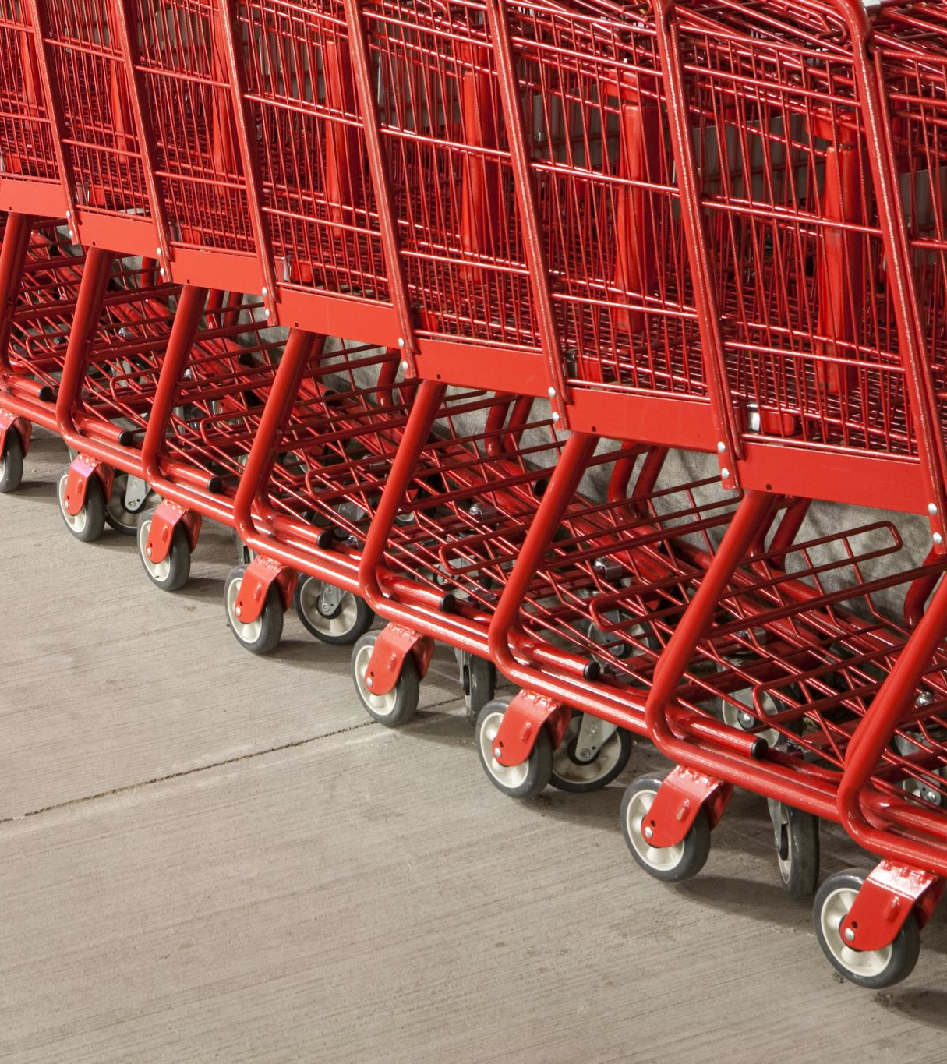
Sunny Malkani Shopping Cart
Rails / React

Slide 2
User stories
Search for items from a product catalog
Add items to Shopping Cart
Checkout Shopping Cart
Return to Shopping and Continue to Add items
Remove Items from Shopping Cart
Optional: Save shopping cart (requires login)

Slide 3
Models
Products – ProductID, Name, Description, Category, Keywords, Price, ImageURL (This will be pre-populated) (Show/Index)
CartItems – ItemID, ProductID, Price, Qty, (CartID) (Created, Updated, Destroyed)
UserCart – CartID, UserID, LastAccessedDate (Create, Update, Destroy)
User – UserID, Email, Password (Create, Update)
Primary Key
Foreign Key
USER
PRODUCT
USERCART
CARTITEMS

Slide 4
Search for items from a product catalog
Keywords
Product Cards - Name, Description, Category, Keywords, Price, ImageURL
Category
Price Min - Max
Product Cards - Name, Description, Category, Keywords, Price, ImageURL
Product Cards - Name, Description, Category, Keywords, Price, ImageURL
Product Cards - Name, Description, Category, Keywords, Price, ImageURL

Slide 5

Add items to shopping cart
Keywords
Product Cards - Name, Description, Category, Keywords, Price, ImageURL
1
Category
Price Min - Max
Product Cards - Name, Description, Category, Keywords, Price, ImageURL
2
Product Cards - Name, Description, Category, Keywords, Price, ImageURL
4
Product Cards - Name, Description, Category, Keywords, Price, ImageURL
0

Slide 6

Checkout shopping cart
Keywords
Product Cards - Name, Description, Category, Keywords, Price, ImageURL
1
Category
Price Min - Max
Product Cards - Name, Description, Category, Keywords, Price, ImageURL
2
5
Product Cards - Name, Description, Category, Keywords, Price, ImageURL
4
Product Cards - Name, Description, Category, Keywords, Price, ImageURL
0

Slide 7


Checkout shopping cart/Return to Shopping/Remove Items from Shopping Cart
4
Product Cards - Name, Description, Category, Keywords, Price, ImageURL
1
Product Cards - Name, Description, Category, Keywords, Price, ImageURL
2
Total Due: $NNN
Product Cards - Name, Description, Category, Keywords, Price, ImageURL
4
Product Cards - Name, Description, Category, Keywords, Price, ImageURL
0

Slide 8

Optional: Save shopping cart (requires login)
4
Product Cards - Name, Description, Category, Keywords, Price, ImageURL
1
Total Due: $NNN
Product Cards - Name, Description, Category, Keywords, Price, ImageURL
2
Product Cards - Name, Description, Category, Keywords, Price, ImageURL
4
Product Cards - Name, Description, Category, Keywords, Price, ImageURL
0

Slide 9
Optional: Save shopping cart (requires login)
Login
Signup
4
Product Cards - Name, Description, Category, Keywords, Price, ImageURL
1
Total Due: $NNN
Product Cards - Name, Description, Category, Keywords, Price, ImageURL
2
Product Cards - Name, Description, Category, Keywords, Price, ImageURL
4
Product Cards - Name, Description, Category, Keywords, Price, ImageURL
0

